Slide 1

AABE Atlanta
Media Coverage

Slide 2
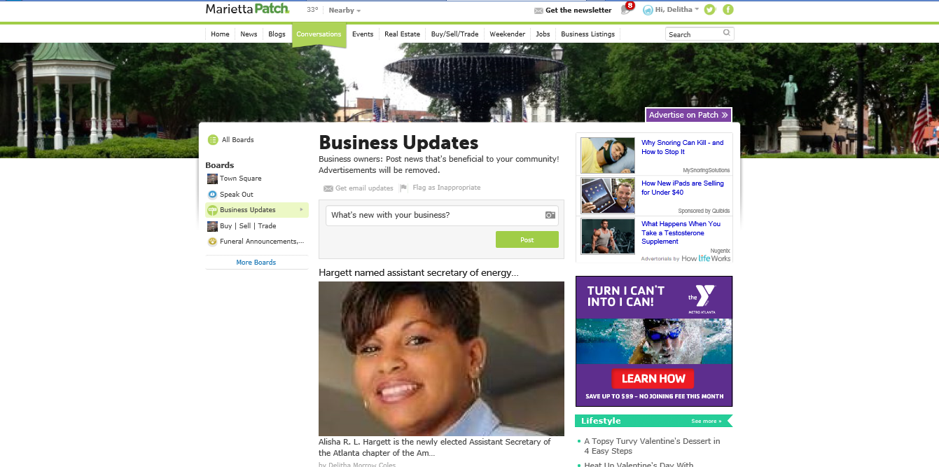
Marietta Patch

Slide 3
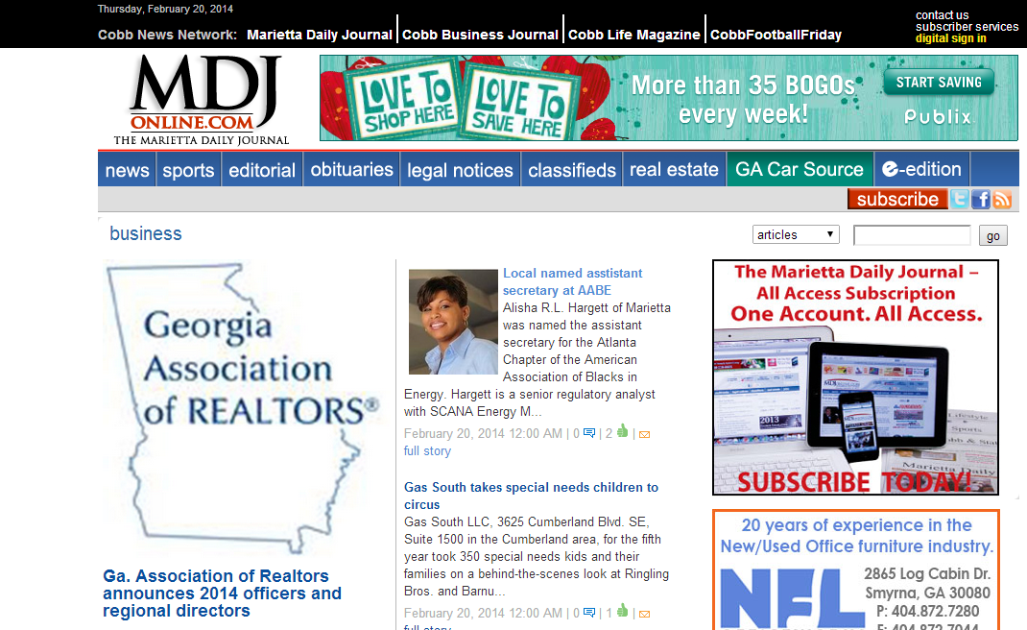
Marietta Daily Journal Online

Slide 4
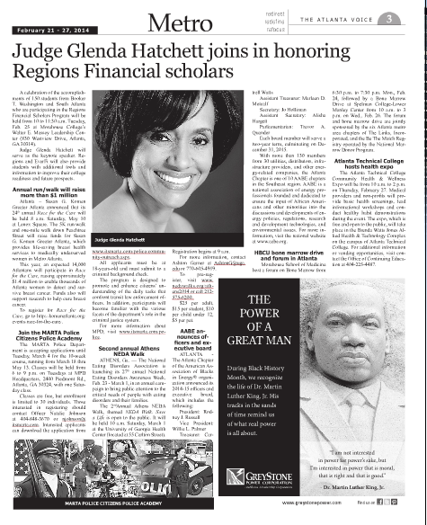
The Atlanta Voice

Slide 5
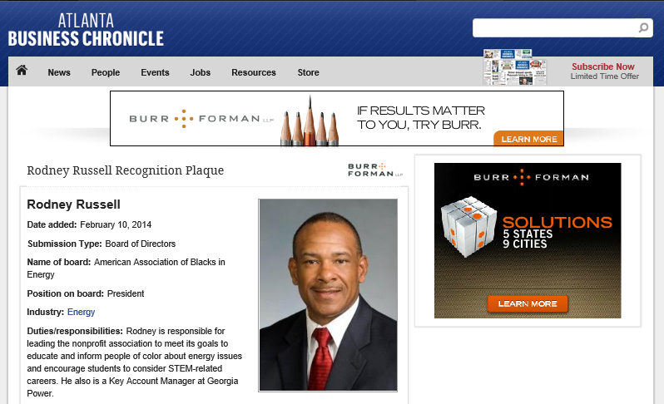
Atlanta Business Chronicle

Slide 6
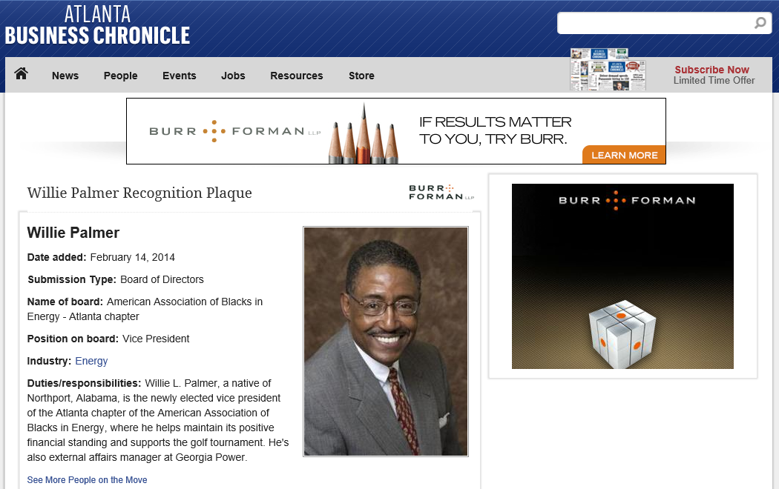
Atlanta Business Chronicle

Slide 7
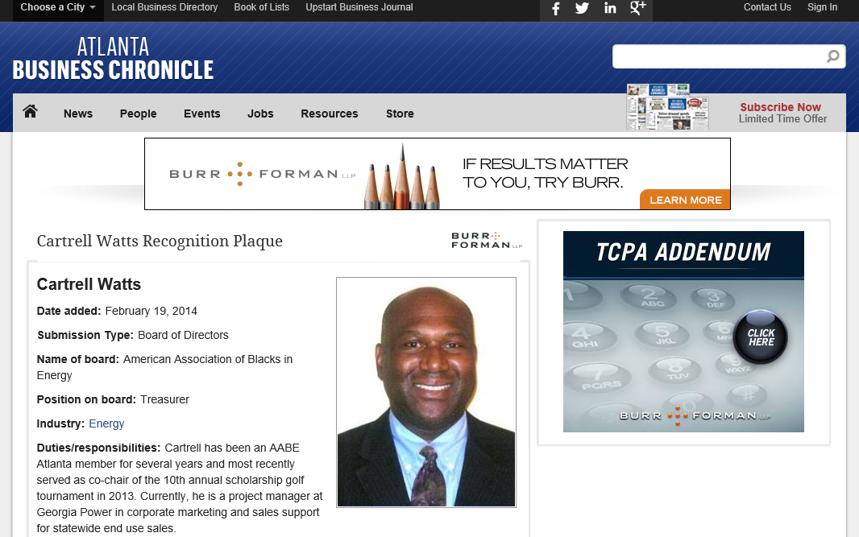
Atlanta Business Chronicle

Slide 8
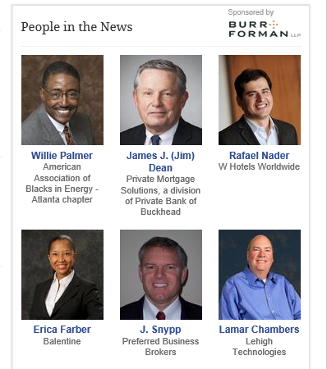
Atlanta Business Chronicle
Atlanta Business Chronicle

Slide 9

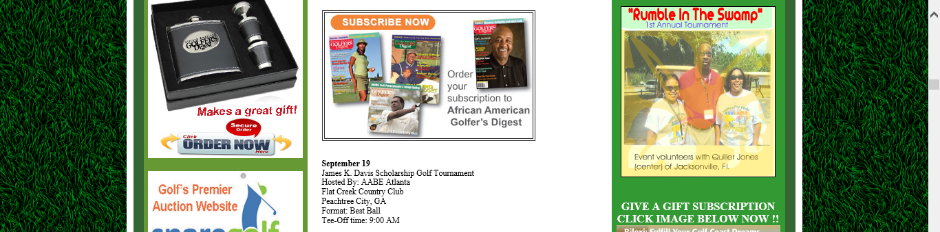
African American Golfer’s Digest

Slide 10
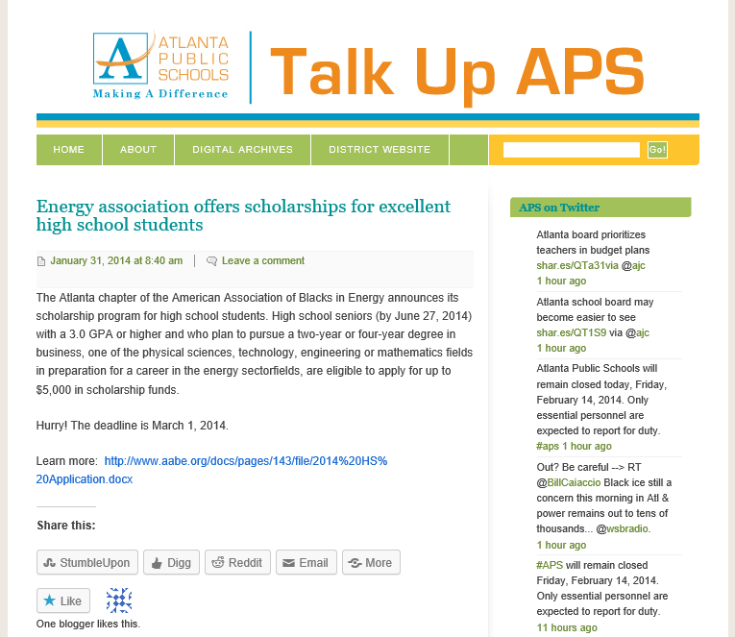
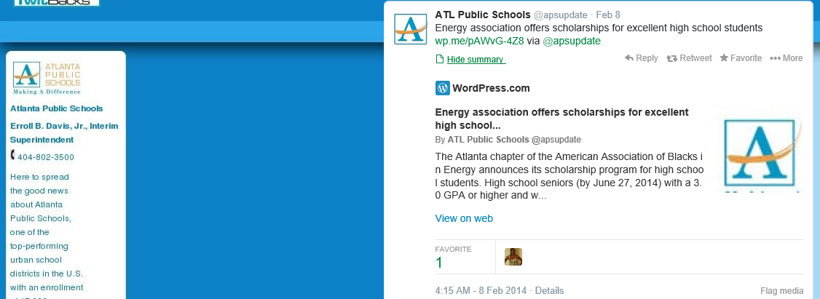
Atlanta Public Schools – Twitter
Atlanta Public Schools – Talk Up APS blog

Slide 11
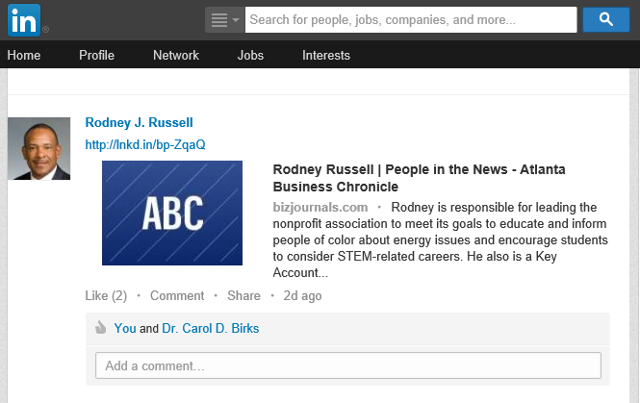
LinkedIn

